Slide 1
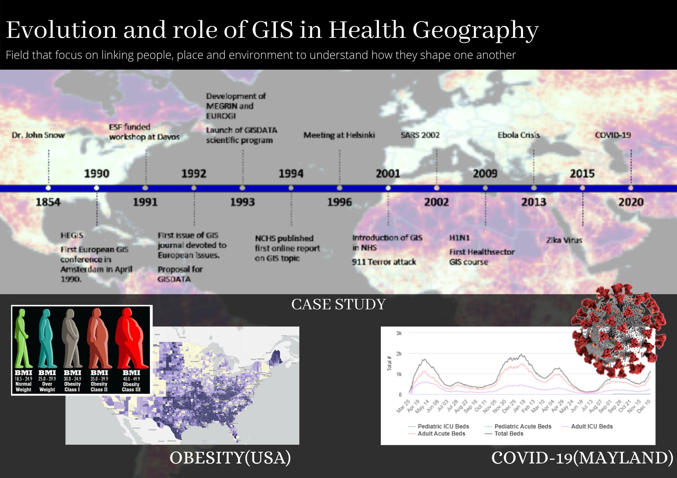

Slide 2

Evolution and role of GIS in Health Geography
Submitted By: Rahul Chahel (52100749)
Submitted to: Dr. Anshuman Bhardwaj

Slide 3
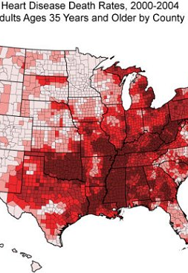
GIS IN Health Geography
Health geography is the field that focus on linking people, place and environment to understand how they shape one another.
The Health geography was first practiced by Dr.John Snow to identify relation between patients suffering from cholera, their surrounding attributes and spatial attributes.
In last three decades, the application of GIS in Health sector to analyse different issues and systematic resolution developed and increased at global level.

Slide 4
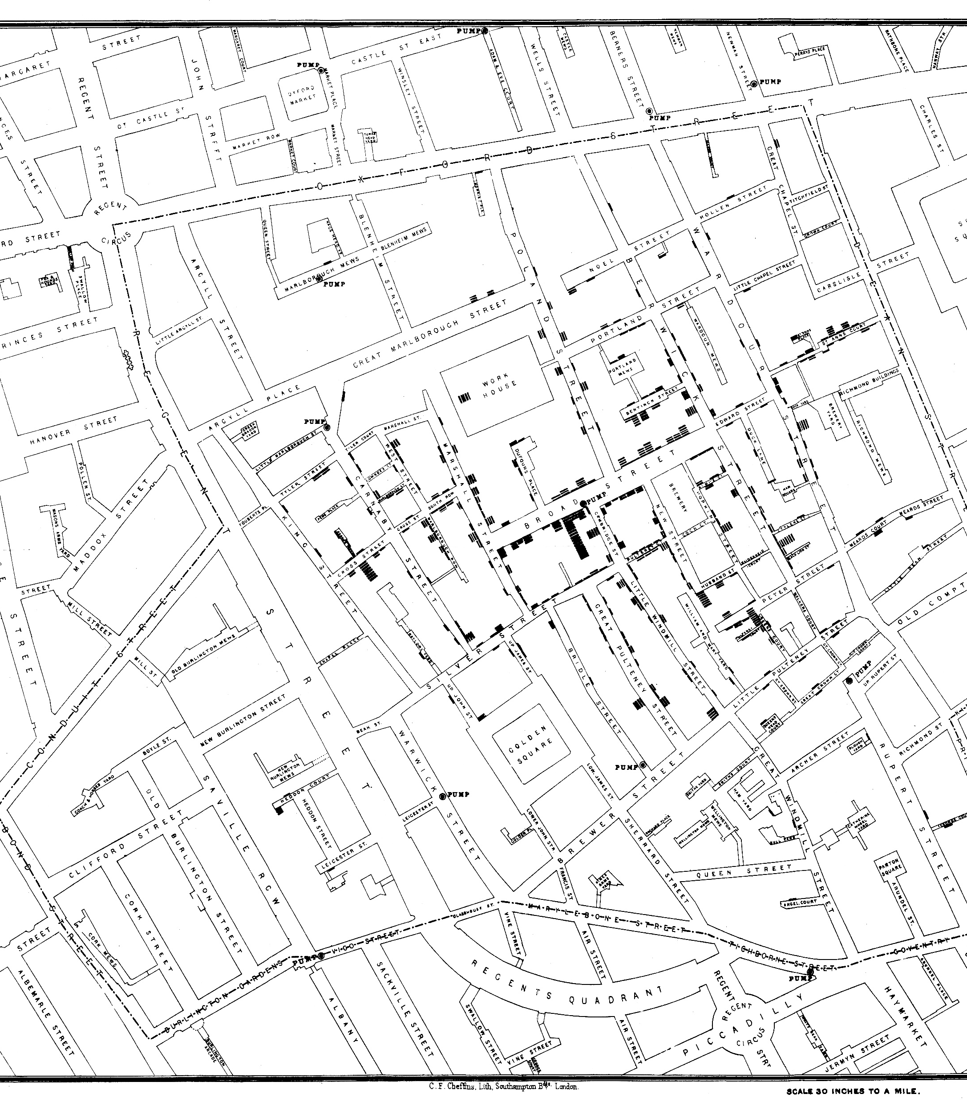
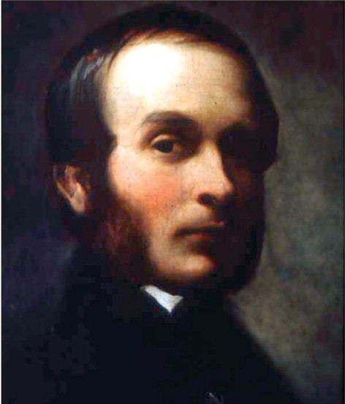
Dr.John Snow
1854
Dr. John Snow was a medical physician and pioneer in the field of epidemiology. He plotted the addresses of patients suffering from cholera on map and revelled the spatial correlation between deaths from cholera and distance to pumps in Broad street.
Source: https://www.nationalgeographic.org/activity/mapping-london-epidemic/
Source: https://www.gim-international.com/content/article/h1n1?output=pdf

Slide 5
HEGIS- Health and environment gis
1854
1990
In 1990 at National Institute of Public Health and Environmental Protection in Bilthoven, Regional office of WHO assembled a meeting of GIS and Health professionals to setup the Health and Environment GIS (HEGIS)
Source: DE LEPPER M.J.C., SCHOLTEN H.J. and STERN R.M. (eds) (1995) The Added Value of Geographical Information Systems in Public and Environmental Health. Kluwer Academic Publishers, Dordrecht.

Slide 6

European gis community (1990-93)
1854
1990
1993
Apr. 1990
First European GIS conference in Amsterdam.
Feb. 1992
The publication of first issue of GIS journal devoted to European issues
June 1993
Development of Multipurpose European ground-related information network (MEGRIN).
1993
Establishment of European organization for geographic information (EUROGI).
Source: https://etheses.whiterose.ac.uk/14818/1/341793.pdf

Slide 7
gisdata
1854
1990
1993
Originated in January 1991, European Science Foundation funded a workshop at Davos in Switzerland to explore the need for a European level GIS research programme.
In 1992, detailed proposal for GIS scientific programme was prepared by a small coordinating group.
In January 1993, GISDATA scientific programme was launched.
It was launched as 4 year scientific programme of the standing committee of Social Sciences of the European Science Foundation.
More than 300 Scientists from 20 European counters participated in programme.
Source: Gattrell, A., Loytonen, M. (2003). GIS And Health: GISDATA 6. United Kingdom: Taylor & Francis.

Slide 8
Public health gis news and information
1854
1990
1993
In 1994, National Center for Health Statistics started publishing online report that provided timely information on variety of GIS topics.
It included technical assistance, notification of professional meetings, events and conferences, communication from system users, and review of new GIS literature.
It was defined as ‘Dedicated to scientific excellence and the advancement in disease control and prevention through the use of geographic information systems (GIS) technology.
1994
Source: Mullner, R.M., Chung, K., Croke, K.G. et al. Introduction: Geographic Information Systems in Public Health and Medicine. Journal of Medical Systems 28, 215–221 (2004).

Slide 9
Meeting at Helsinki
1854
1990
1993
In June 1996, A total of 16 participants from Europe and USA who were using GIS in health related research or using health as a platform for development of GIS-linked methodology meet in Helsinki .
The skillset of Geographers, Statisticians, Epidemiologists and Environmental scientists were all brought together.
1994
1996
Source: https://etheses.whiterose.ac.uk/14818/1/341793.pdf

Slide 10
Clarifying the current and potential use of GIS within NHS organisations
1854
1990
1993
In 2001, Higgs and Gould purposed the usage of Geographical Information systems in UK’s National Health Service.
Higgs and Gould purposed GIS application falls into two categories:
Epidemiological (Pattern analysis)
Health Care Delivery (Optimisation of healthcare services and accessibility)
1994
1996
2001
Source: Smith, D, Higgs, G & Gould, M 2001, 'Clarifying the current and potential use of GIS within NHS organisations: optimism or pessimism?', British Journal of Healthcare Computing and Information Management, vol. 18, no. 7, pp. 24-26.

Slide 11

9/11-Terror Attack
1854
1990
1993
After 9/11 Terror Attack there was increment in number of Emergency planners that use GIS for development of disaster responses to terror attacks and natural disasters in USA.
1994
1996
2001
Source: Mullner, R.M., Chung, K., Croke, K.G. et al. Introduction: Geographic Information Systems in Public Health and Medicine. Journal of Medical Systems 28, 215–221 (2004).
Source: https://www.theatlantic.com/photo/2011/09/911-the-day-of-the-attacks/100143/

Slide 12
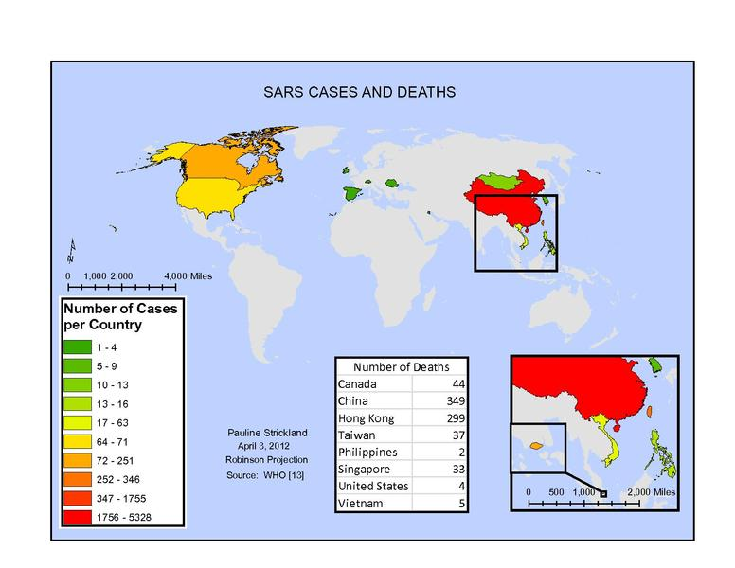
Sars 2002 and 2003
1854
1990
1993
Organisations involved: Hong Kong health officials, Esri
During Severe Acute Respiratory (SARS) outbreak in Chine in 2002 and 2003, local GIS experts helped health department track the disease.
WHO published daily updates to disease maps on SARS website. The maps were static yet up-to-date with latest data reported by the local authorities.
In Hong Kong, highly hit area, a SARS map team used department of health updates to geocode case information against Hong Kong street and building databases.
The map presented information on suspected, actual and recovered SARS cases and was easily available on website.
1994
Source: https://upload.wikimedia.org/wikipedia/commons/3/33/Sars_Cases_and_Deaths.pdf
1996
2001
2002-3
Source: https://www.esri.com/about/newsroom/blog/maps-that-mitigate-epidemics/

Slide 13

H1N1-2009
1854
1990
1993
Organisations involved: Centers for Disease Control and Prevention(CDC)
In 2009, A new strain of influenza H1N1 was first identified (called ‘swine flu’ later ‘Mexican flu’).
Transmission was human-to-human, by air and by body contact. Due to intensive travelling of people, the virus spread globally at an unprecedented speed.
Scientists and researchers were studying global spread of virus using advanced geographic information system to analyse the development of pandemic and planning the way to reduce the effects.
1994
1996
2001
2002
2009
Source: https://www.gim-international.com/content/article/h1n1?output=pdf

Slide 14
First Healthcare sector focused gis course
1854
1990
1993
Organisations involved: Southern California Public University
Southern California Public University in spring 2009 offered a GIS course focused on the healthcare sector.
It was open to all health care administration, health science and geography majors or researchers that wanted to solve spatial questions related to healthcare.
The introduction of the course was inspired by the application of GIS to analyse the H1N1 spread and planning to check the spread of future pandemic.
1994
1996
2001
2002
2009
https://scholarworks.csun.edu/bitstream/handle/10211.2/2792/CAgeographer2009_p86-106.pdf;sequence=1

Slide 15
Ebola crisis
1854
1990
1993
Organisations involved: WHO
During 2013 to 2019 Ebola crisis, health and government agencies used GIS to understanding the virus by help in determining it’s causes, origin and trace how it travels. To help fight the outbreak, the WHO published live maps of ‘conformed cases in South-Saharan Africa’.
Agencies also used mapping technology to site emergency Ebola treatment centers, manage bed capacity and care accessibility.
Outbreak declared an international public health emergency and precipitated coordinated response that include data collection using apps on mobile.
Health agencies also included layer with local religious center for safe and dignified burials and keep track of the location of teams who were educating people about the burial methodology.
1994
1996
2001
2002
2009
2013-19
Source: https://www.esri.com/about/newsroom/blog/maps-that-mitigate-epidemics/

Slide 16
Zika Virus
1854
1990
1993
Organisations Involved: National Aeronautics and Space Administration, WHO, CDC, Department of Health and Mental Hygiene(New York)
In 2015, Zika virus broke out in Brazil and quickly grew to epidemic level in many countries. Zika was a mosquito-borne virus and caused concern amongst pregnant woman as cause severe brain damage in fetus due to microcephaly.
NASA used GIS to forecast risk by modelling the conditions that create suitable habitats for the virus carrying mosquitos, such as temperature, water, tree cover density, elevation, precipitation and seasonal changes.
WHO and CDC used GIS to analyse data related to mosquito habitat to predict locations of Zika and population vulnerable to infection.
Department of Health and Mental Hygiene, New York used GIS to predict high risk areas and outreached neighbourhoods and clinics with pregnant women.
1994
1996
2001
2002
2009
2013
2015
Source: https://www.esri.com/about/newsroom/blog/maps-that-mitigate-epidemics/

Slide 17
GIS applications in obesity research Case study:
Launch Year: 1980
Link: https://www.cdc.gov/obesity/index.html
Organisations involved: World Health Organisation(WHO), Centers for Disease Control and Prevention(CDC), National Center for Health Statistics (NCHS).
Sister Technologies used: Global Positioning Systems(GPS), Remote sensing

Slide 18
GIS applications in obesity
The recognition of obesity as a disease was in theory established in 1948 by WHO, highlighting of the potential public health problem in the United States and the United Kingdom 35 years ago was considered irrelevant elsewhere.
Due to the early highlight, the collected data related to obesity in USA is in abundance on public platform. In last two decades, various studies and analysis have been conducted on this issue. The obesity data was analysed with other socio-economic data, majorly related to education, accessibility to recreational facilities and healthy food availability.

Slide 19
GIS data and attributes involved
Street connectivity- Number of intersections and nodes of street network
Walkability- Walk Score correlation with level of physical exercise
Urbanicity- Built Environment and Obesity relation
Food Environment- Access to health food and Ratio with Fast food.
Sociodemographic Variables- Race, Ethnicity relation with Obesity
BMI Data- BMI data as a scale to measure obesity
Poverty- Economic status
Location of Recreational Center and Parks- Distance form Parks and Recreational Center
Other Diseases- Diabetes, Asthma and more

Slide 20
Application of gis during covid-19 Case study: MAYLAND COVID-19 DASHBORD
Launch date: 14 March, 2020
Cost: Nil(Due to prior ArcGIS state-wide enterprise system)
Link: https://coronavirus.maryland.gov/
Organisations Involved:
Mayland Information technology Department
Emergency Management Agency
Health Department
Geographic Information Office(GIO)
Technology involved: ArcGIS, Database Management system

Slide 21
MAYLAND COVID-19
Mayland’s ( United States of America) Geographic Information Office(GIO) launched ‘Coronavirus Disease 2019 Outbreak site’ on 14 March,2020.It was rolled out in just four hours due to presence of state’s ArcGIS enterprise system and collaboration of different departments.
The portal is embedded with Data Dashboard including Map and Statistical data visualisation.
Map data visualisation is visually interactive, contain data of number of Covid cases, Testing and can be classified using different spatial factors such as County, Zip code.
Statistical Visualisation include different plots with different attributes for analysis of covid situation and other related attributes.

Slide 22
MAYLAND COVID-19 DATA and interrelation with other data
Cases by County, ZIP code –Cases data joined with Spatial data
Testing by County- Testing data joined with Spatial data
ICU and Acute Hospital Beds for COVID-19- Hospital database relating to Spatial data
Testing Volume- Testing statistical data for Statistical visualisation
Testing Statistics
Vaccination statistics- Vaccination Statistics joined to Spatial data
Cases Hospitalised by Vaccination Status- Hospitalisation data joined with vaccination data with Spatial reference
Cases among fully vaccinated- Covid data relating with Vaccination data and Spatial data

Slide 23

Thank you

